Slide 1

Viva Presentation
Procedural Generation of Realistically Scaled Planets
Adam Hurst
Notes:
Welcome to my presentation
My name
Say name of project

Slide 2
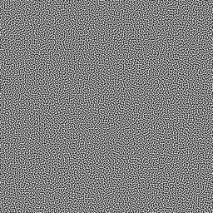
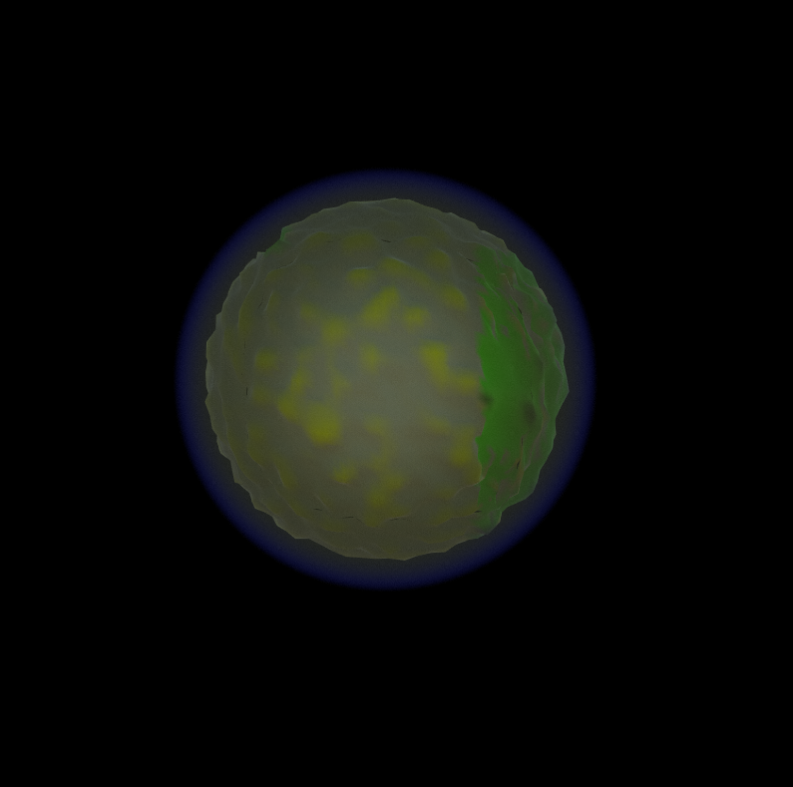
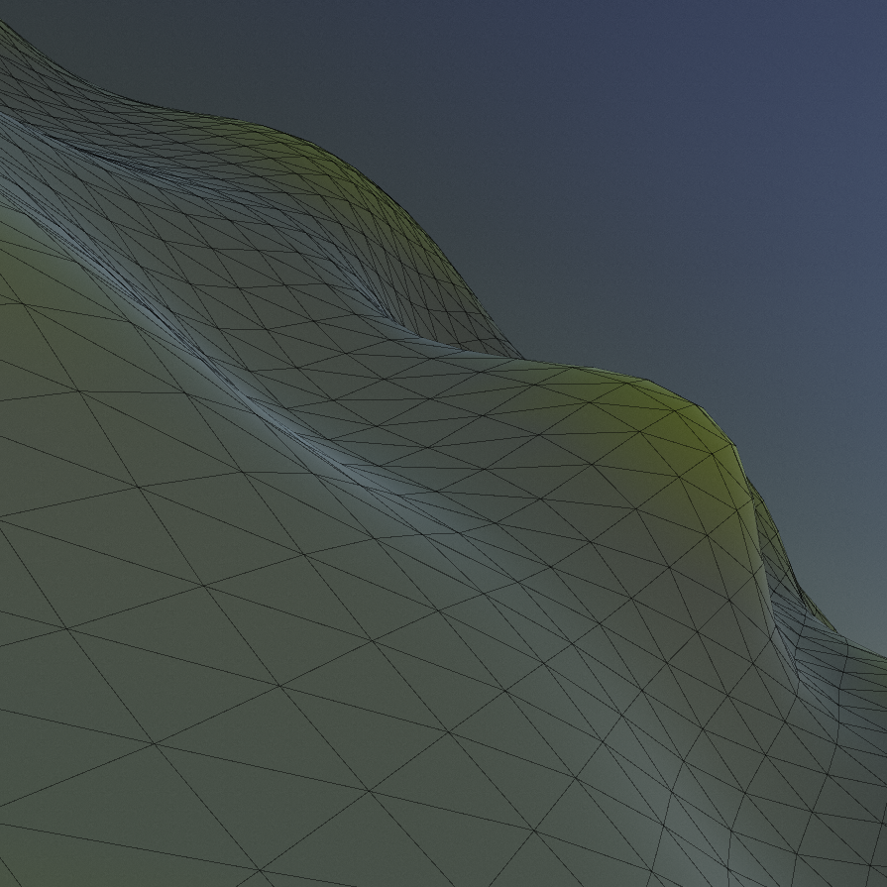
Topics
Context
Research
Design
Product Demonstration
Evaluation and Conclusion
Notes:
Talk about all the topics for today
Context
What the project is and where it stands within research and the industry
Why is this thing important
Research
Brief summary of the areas that were researched
Design
Information on what was design and implemented
Discuss the making of the actual product
Product demo
Show-off a demonstration of the package and the application
Evaluation
Talk about how the product ended up working
Show some graphs and close ups of the product
Conclusion
What could be done better, what has been learened

Slide 3

Context
Notes:
To start I'm going to discuss the context of this project within research and where it lies within the industry
The trend of procedural generation has been increasing in games within recent years
Specifically, within the sci-fi genre, with the use of procedurally generated planets
Some games feature this as a suplemnatary feature (space engineers, elite dangereous)
Some games feature this as a main game play feature (no mans sky)
PCG allows for developers to quickly and easisly generate game worlds, and spend more time on developing gameplay mechanics

Slide 4
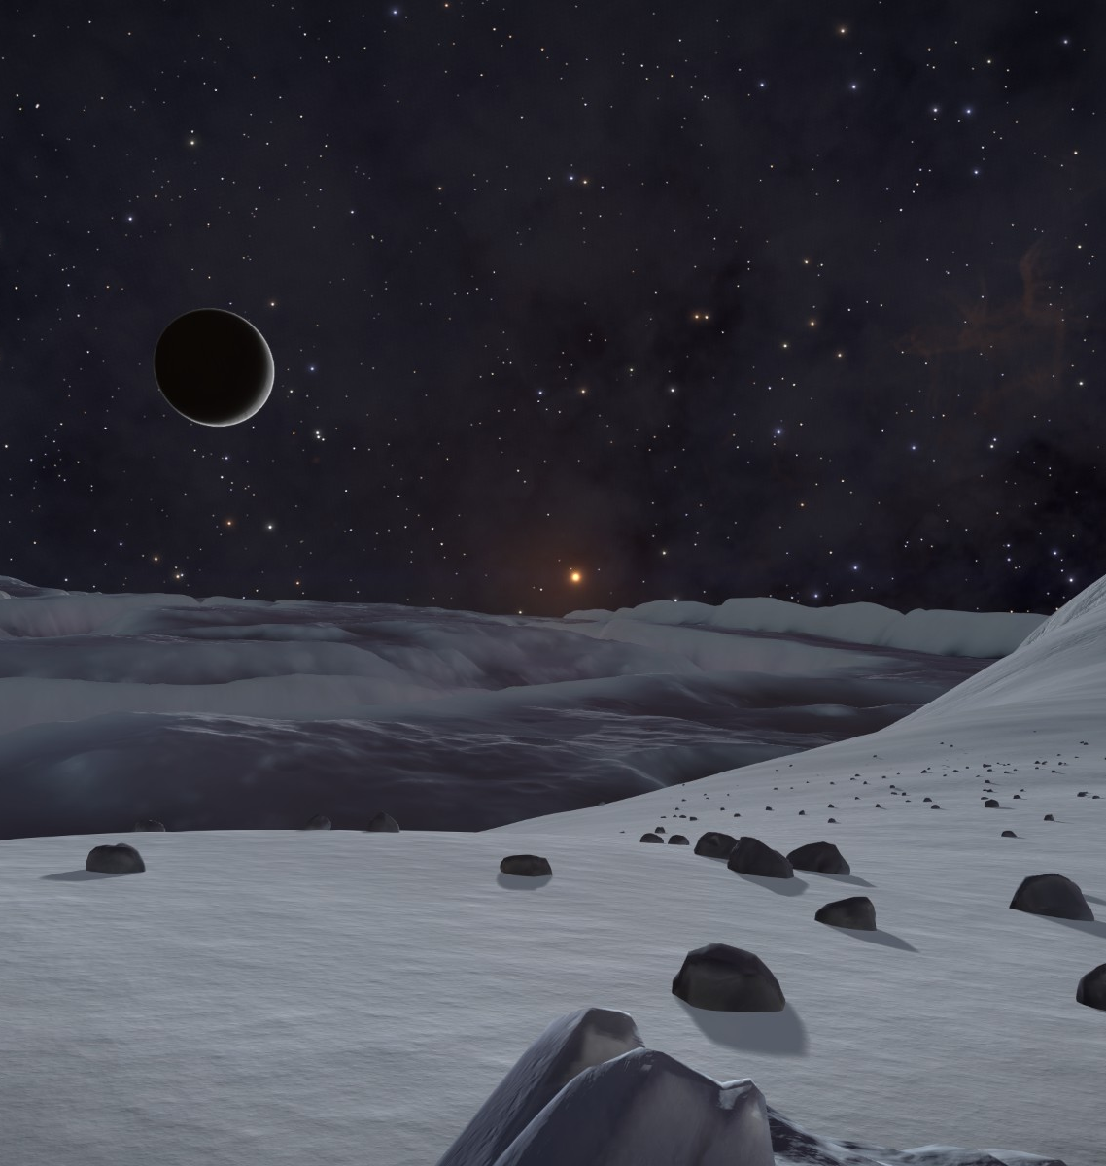
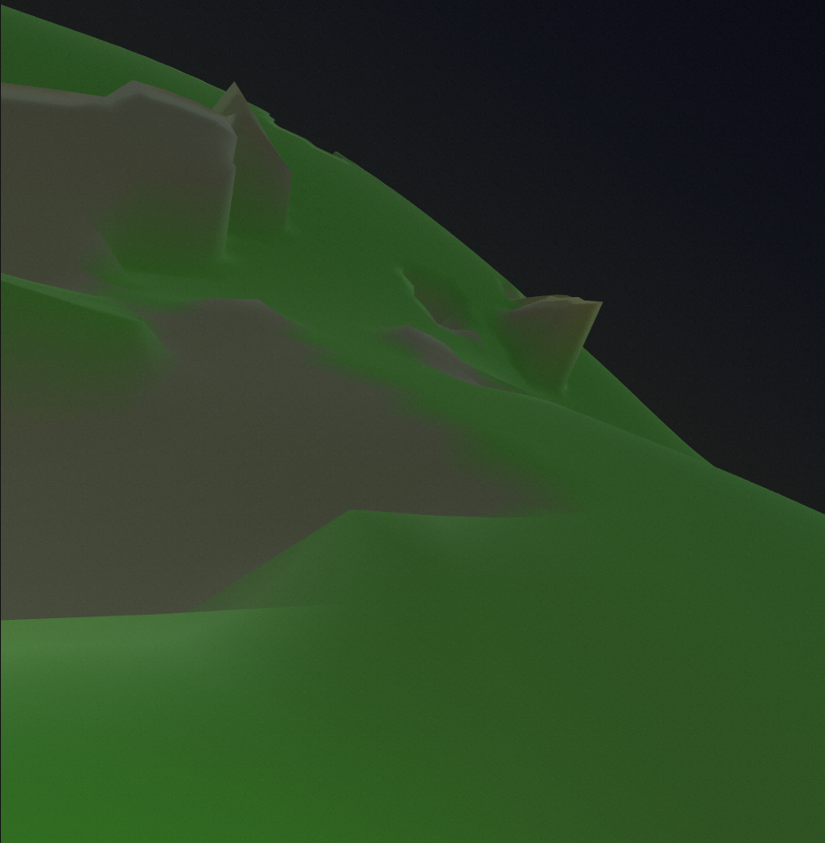
Notes:
Some problems with these implemented approaches
Inaccessible to other developers
Not to a realistic scale
Aims and objectives of this project
Wanted to create a system that was easy and accessible for developers to use
Create realistic scaled planets

Slide 5
Research
Notes:
Instead of covering the research as I did in my last presentation, I'm just going to do a brief summary a refresher
Will go into more detail on some sections when talking about their design and implementation
The main topics of research were
Mesh generation
How to generate the actual mesh of the planet for the terrain to go on to
How to generate the verticeis of a sphere, that is well distributed and accurate
Level of detail systems
Find a way to allow for changing the mesh’s detatil and resolution depending on the camera’s location
Crucial for the scale that is being targeted
Floating point precision errors
The issues that arise when floats becomes so large that they do not have enough decimal precision
Find ways to fix / alleviate these issues
Procedural terrain generation
How to turn the mesh into something that resembles terrain
Includes:
Noise
Heightmaps
Etc.
Atmospheric rendering
How to create a simulated atmosphere for the planets
Another layer of realism and immersion
Rayleigh and mei scattering methods

Slide 6
Design
Notes:
This section will talk about each of the components that was created, and how they were designed
Design philosophy
Took a very iterative approach, so many great theorists
One approach was tried and tested for its effectiveness
This was repeated until an ideal method was found
Take a user friendly approach
Use of unity
Acceible
Scriptable obejects for the purpose of non-code configuration

Slide 7
Mesh Generation
Terrain Generation
Level of Detail
Atmospheric Rendering
Main Areas of Development
Notes:
Here are the 4 main areas of development within this project, these are:
Mesh generation
The generartion of the sphere mesh
Terrain generation
Creating the distinct biomes
Morphing the mesh to create terrain
Atmospheric rendering
Create the atmosphere
Level of detail systems
Increase/Decrease the mesh resolution for performance and quality reasons

Slide 8
Mesh Generation
For f faces in cube:
AxisA = GetUpOfNormal(Normal)
AxisB = Cross(Normal, AxisA)
For (y < MeshResolution)
For (x < MeshResolution)
Iterator = x + y * MeshResolution
Percent = (x, y) / (MeshResolution - 1)
PointOnUnitCube = Normal + (Percent.x – 0.5) * 2 * AxisA +
(Percent.y – 0.5) * 2 * AxisB
PointOnUnitSphere = Normalize(PointOnUnitCube) * Radius
Vertices[Iterator] = PointOnUnitSphere
If x != MeshResolution - 1 And y != MeshResolution -1
Triangles[NumberOfTriangles] = Iterator
Triangles[NumberOfTriangles + 1] = Iterator + MeshResolution + 1
Triangles[NumberOfTriangles + 2] = Iterator + MeshResolution
Triangles[NumberOfTriangles + 3] = Iterator
Triangles[NumberOfTriangles + 4] = Iterator + 1
Triangles[NumberOfTriangles + 5] = Iterator + MeshResolution + 1
NumberOfTriangles += 6
Notes:
The first area that was implemented was the mesh generation
Is the core of the design, everything but the atmosphere is built on top of it
Two main methods to choose from based off of research, normalised cube and sperified cube
They were compared for effiecy and accuracy
Normalised cube was chosen for its lack of use of square root maths
On screen now is a sudo-code algorithm for a noramlised cube (inspired by sebasian lagues work)

Slide 9
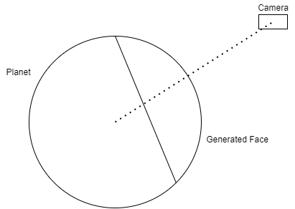
Mesh Generation
Notes:
This standalone was good, but requires some work
Would always generate the faces you passed into it, the cardinal directions
A way to generate only the visible faces was required
1st iteration
The first method involved calculating whether or not the camera was facing the planet
Used the cameras normal to calculate whether or not it fell within some arbitrary threshold
Still depended on the use of the cardinal vectors
Correct face would not always generate
Gaps would occur
2nd iteration
Generated the face relative to the position of the player
Generated the normal for the face generation every frame
Is the diagram on screen now
Would generate the face directly beath the player at full res, and the 4 surrounding faces at a much lower resolution
This was much more reliable and looked a lot better
Non of the previous issues would occur
This method optimised for LOD as well
Extra notes
Was originally calculated on the cpu in an ienumeator function over several frames
Moved to a new technology that was learned, compute functions

Slide 10
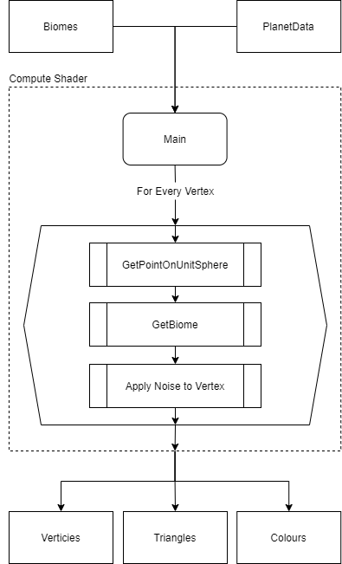
Terrain Generation
Notes:
The basic workflow of this compute shader can be seen on screen now
The next area that was implemented was the terrain generation system, as this is a core component of this shader
Within research the autobiomes paper by fischer et al. was the core inspiration for the system that I wanted to create
This paper detailed a way to create biomes in terrain, to add more variety to regular noise terrain
As you can see on this workflow diagram:
The shader takes in the biome data, and the planet data
Then generates a unit sphere
Then, based off the biome, add noise to the vertex

Slide 11
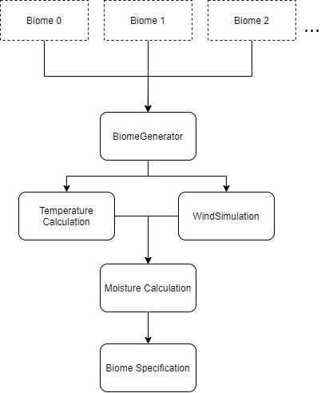
Terrain Generation
Notes:
The biomes as you can see are a core component of the terrain generation
It was decided that this could be precomputed, as it was theorised that it would be to slow for runtime operation
Data was then stored in the BiomeMap,
The biome data, inspired by autobiomes, was calculated in the order as shown above
First the user inputs the biome data, this is stored in scriptabels objects and are easily customisable
This data is then sent to the biomeGenerator class
Weather simulations are then done and the biomes are claisified

Slide 12
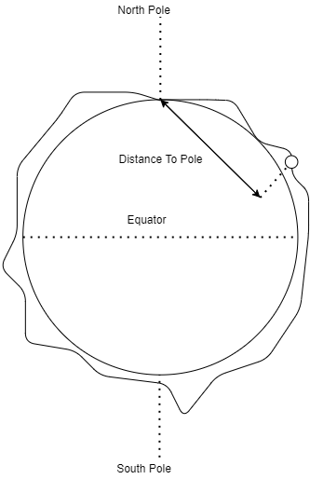
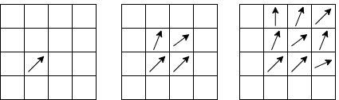
Terrain Generation
Notes:
These weather simulations consist of 3 main steps
Temperature simulation
Diagram to the right
Uses the distance to the pole of the planet, and its relative altitude
These values are multiplied by a user defined modifier to prefer either the altitude or the distance
The values are then combined and averaged to offer a 0-1 temp value
Wind simulation
1st iteration
Attemped a fluid dynamics wind simulation, as stated in the paper
Is the graph to the left
Randomly generated wind origin points aross a map,
These points would then propgate across the surface, simulating wind
Although realistic was difficult to implement
Wind values were exponential
Issues with distribution and performance
This method scrapped
2nd iteration
Much Simpler
Used a simplex noise function to generate sudo random values
Not realistic but would work for biome distinction
Much more efficient
Moisture simulation
Used as the way to define the biomes in auto biomes
Originally planned to use a similar approach to the wind
Using the wind data to diffuse and spread moisture, using the temperature values as well
Instead a calculation was done, the colder and higher the wind, the higher the moiseter and vice versa

Slide 13
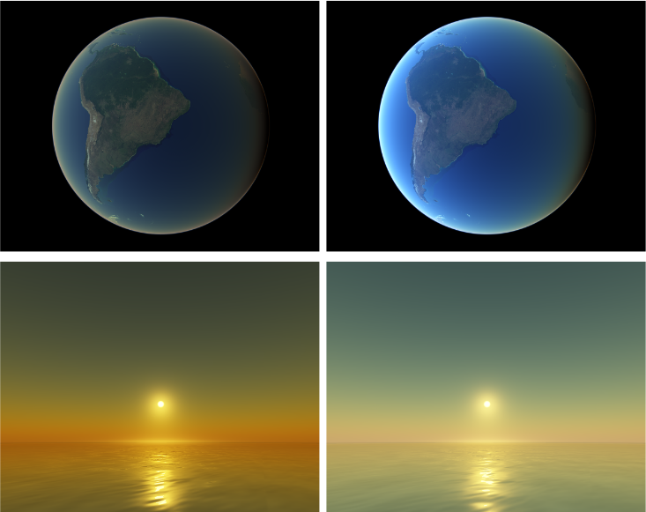
Atmospheric Rendering
Notes:
The next thing added was the atmosphere
Research was done into existing approaches, as it has been well researched
Came across sebastin lagues implemtation
Complete unity implmentaion
Identical to the methods decirbed by Schafhitzel and elek
Took his implementation
Issues arose unfortunately
Had to be converted into unit URP
Lots of tweaks had to be made

Slide 14
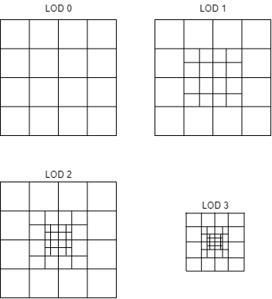
Level of Detail System
Notes:
By far the most difficult component
Unfortnatley was not implemented
The First attempts was geometric clipmapping
Used the concepts behind texture clipmaps and applied them to mesh’s
Generated the terrain around the player, and lowered the resolution the further out the camera was
Desinged for heightmaps, but could be reworked for procedural
Promising, but had issues integrating it with unity’s mesh system, had to be simplified
The second attemps was similar, but a lot more simple
Simply generated the mesh around the player, then made consentric boreders at lower resolution
Is the approach seen on screen now
The higher the lod, the higher the resolution of the mesh
Would also elimineate the outer boreder after a point to lower vertice count
Issues unfortuabtley arose in implmentaion
Calculatuing the border offset
Correct location of mesh
Had to be scrapped

Slide 15
Demonstration
Notes:
The following section features a video demonstration of both how the package works within unity, and quick look at how the end product looks within the provided executable

Slide 16
Package gen demo here

Slide 17
Game demo here

Slide 18
Evaluation
Notes:
This section details the evaluation that was done into the major components of this project.
These include
The mesh’s quality
The performance of the mesh generation process, and factors that may effect it
Ther performance of the biome system, both effiecny and quality
An overall evaluation if I have reached the goals I set ou to accomplish

Slide 19
Mesh Evaluation

Slide 20
Mesh Evaluation

Slide 21
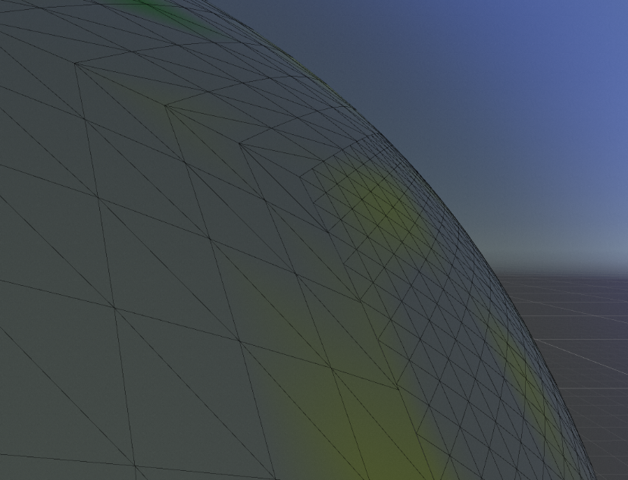
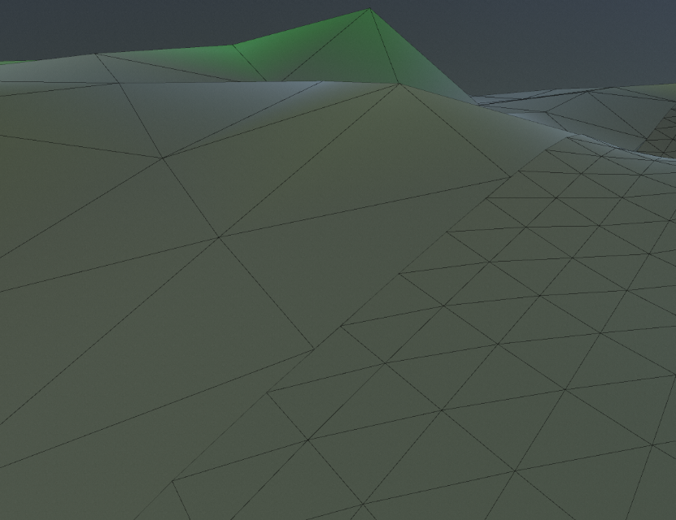
Mesh Evaluation

Slide 22
Terrain Evaluation

Slide 23
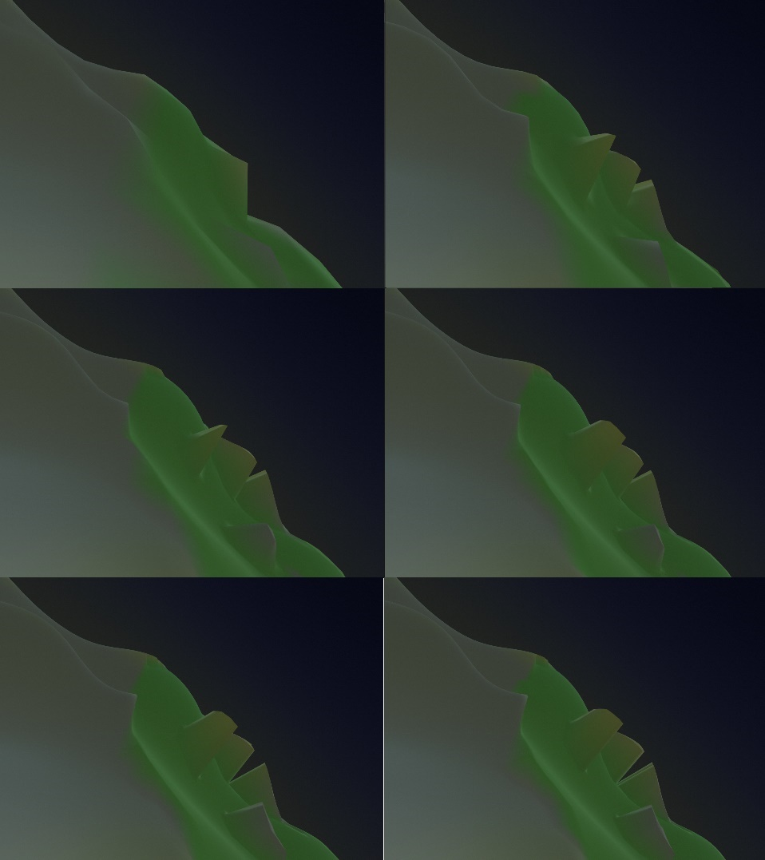
Terrain Evaluation

Slide 24
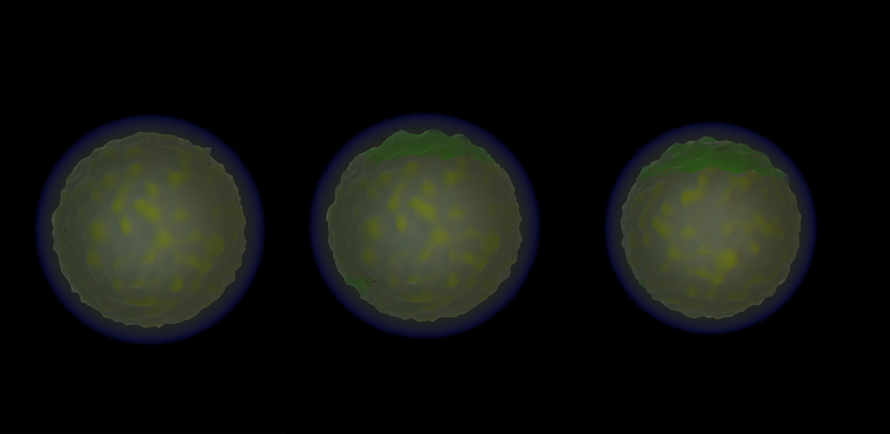
Terrain Evaluation

Slide 25
Conclusion

Slide 26
References

